Slide 1
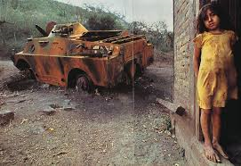
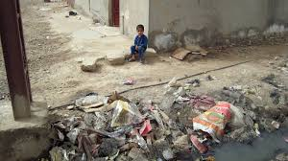
What is going on in these pictures?

Slide 2
Today we are learning…
What international migration is
What are the push and pull factors of international migration
The benefits and challenges of migration

Slide 3
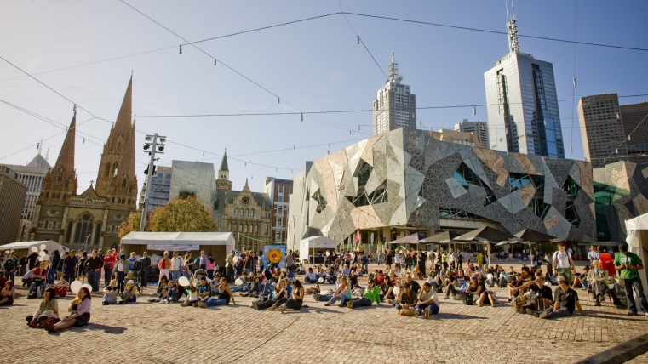
Migration
Migration is the movement of people from one place to another.
Notes:
Start with question – how many of have ever moved house? Technically most people in this room have migrated at some stage or another!

Slide 4
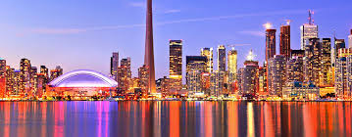
For many people a move to a different country holds many attractions.
This is called international migration.

Slide 5
Immigration is the migration of people into an area.
Emigration is the migration of people out of an area.

Slide 6
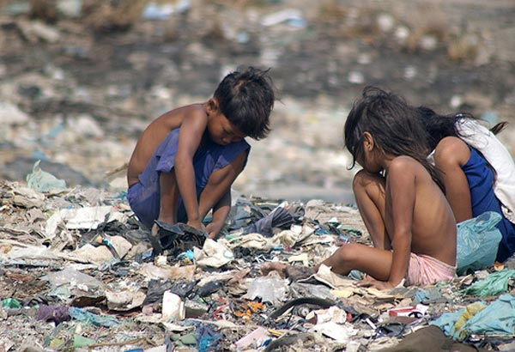
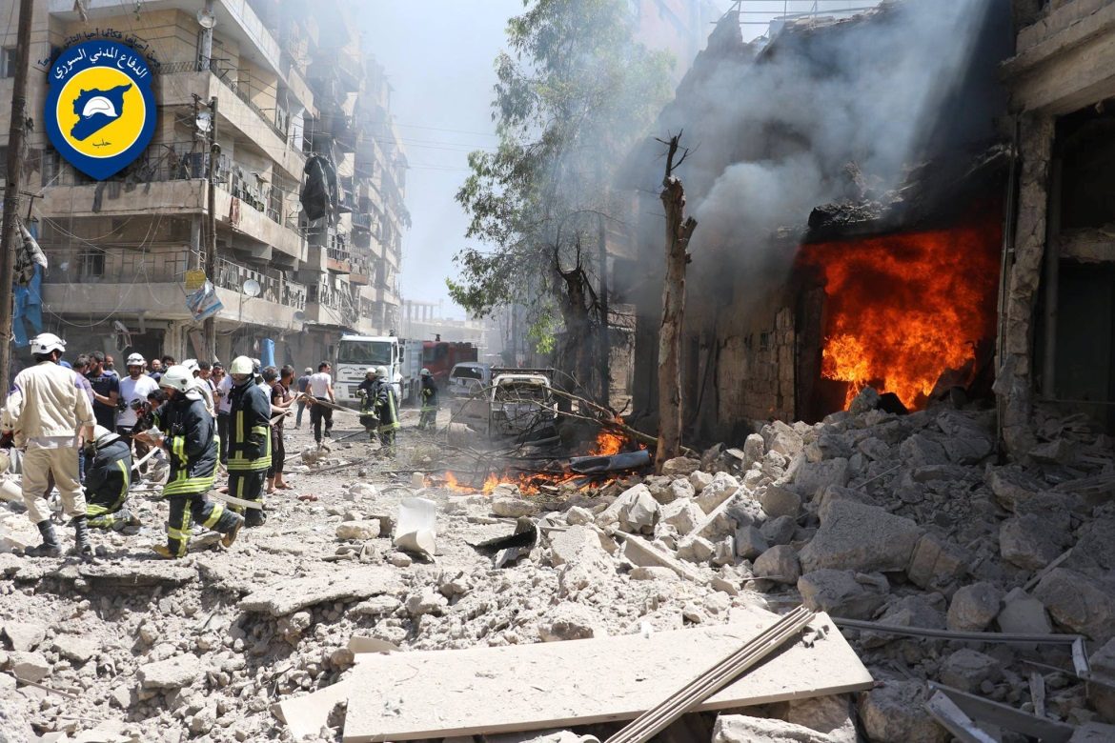
What factors here would influence migration to other countries?

Slide 7


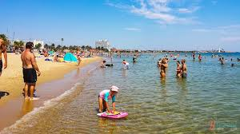
How about these?

Slide 8
Why do people migrate?
People migrate for two reasons:
To get away from things that they do not like. These are known as push factors.
People are attracted to things that they do like. These are called pull factors.

Slide 9
Activity!
Sort the cards you have been given into two columns:
Push Factors ☹
And
Pull Factors ☺
Push Factors ☹ | Pull Factors ☺

Slide 10
Migration as a human right?
Not all countries in the world have the same standards on who is allowed to come into their country.
A migrant is: a person who moves from one place to another in order to find work or better living conditions
An immigrant is: a person who comes to live permanently in a foreign country
A refugee is: a person who has been forced to leave their country in order to escape war, persecution, or natural disaster.
Notes:
Students to copy these into workbooks

Slide 11
Refugee Convention 1951
main international legal document relating to refugee protection.
It defines who is a refugee and outlines the rights of refugees and the legal obligations of states towards refugees and asylum seekers.
Australia has signed and ratified (made into domestic law).
However the issue of refugees arriving by boat to Australia is an ongoing political debate.

Slide 12
Debates about International Migration
https://www.youtube.com/watch?v=lOZmqIwqur4&feature=youtu.be 7mins
1. How many people are there currently away from their place of birth?
2. What are asylum seekers fleeing?
3. What does the Geneva Convention state clearly?
4. Describe an example of illegal migration
5. Which countries share the highest percentage of migrants?
6. What are citizens of the EU allowed to do?
7. Describe one fear felt by destination countries
8. Migration can be perceived as ___________ problem.
9. Describe two advantages of migration.

Slide 13
Activity!
Imagine you are a migrant from one of the pictures we looked at earlier this week (e.g a war torn country).
You have just arrived in Western Australia, think about what problems you would face in a new country, an answer the following;
What ‘pushed’ you from your home country?
What ‘pulled’ you to Western Australia?
What might your first few days be like in the country?
Think about language difficulties, making friends, finding a job etc.
Notes:
10 - 15 mins for this activity. Feedback

Slide 14


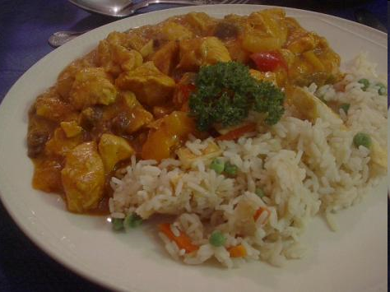
Conclusion
What are the benefits of migration?
Think about the origins of your favourite foods!
And even your favourite music!

